Slide 1

iService

Slide 2

iService
Product history
Version 1.0
Version 1Plus
Version 3
Home Page optimization, Video Play, Custom module.
Smart home, Mobile key, Interactive, Data analysis.
iServices-iPad released on the apple store, including apartment introduction, city life, surroundings information, travelling guide and interactive service 5 modules
2015.2
2016.4
2017-2018
2015.9
2016.9-2017.5
Version 1.6
Version 2
IOS iPhone、Android.
Navigation, Activity module, Promotion and Room amenities order
New revision, real-time room status, booking engine, self check-in/out, Property life, Social media sharing.

Slide 3

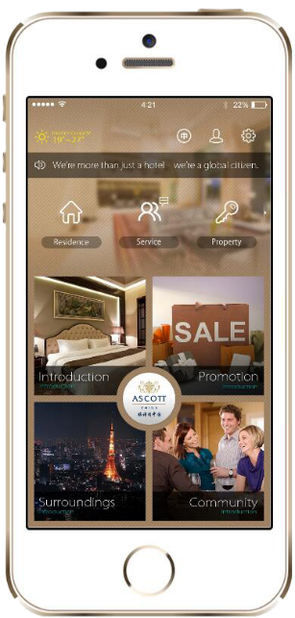

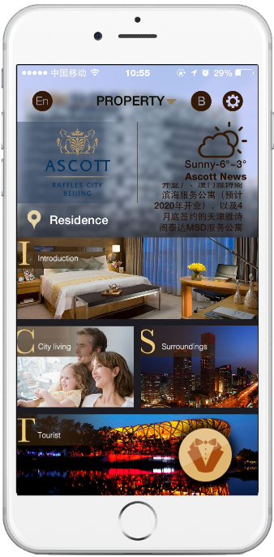
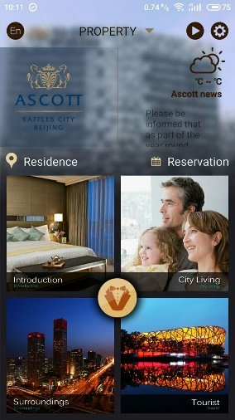
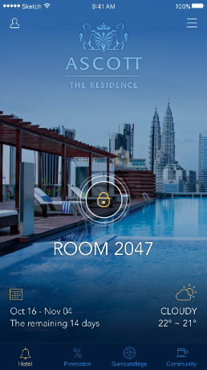
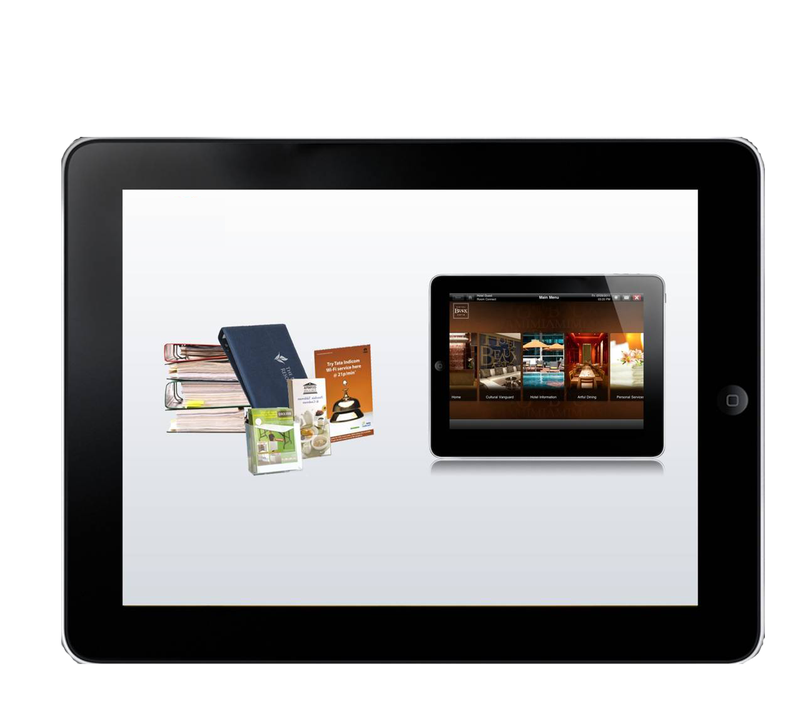
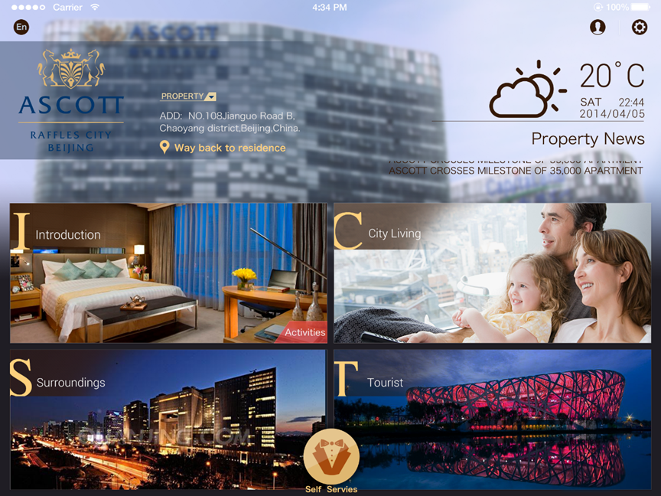
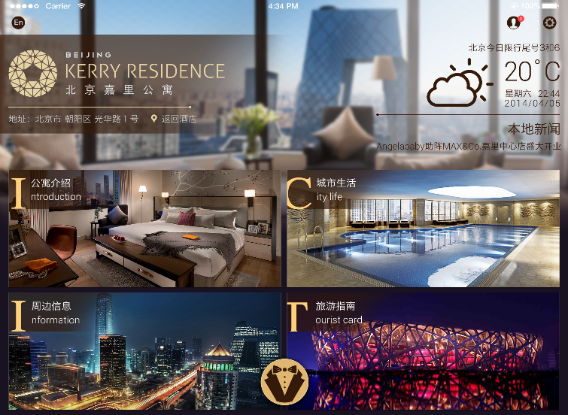
iService

Slide 4

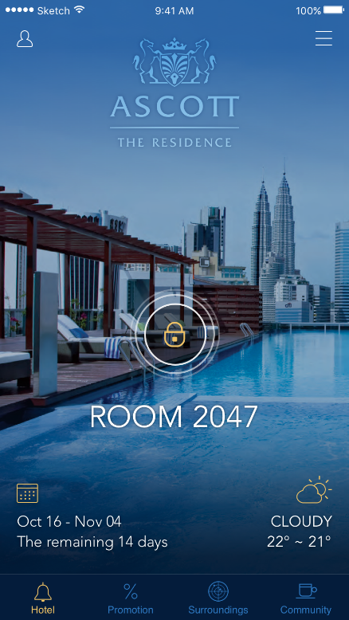
iService
Introductions
Functions & Features
Booking
Push News
Smart Room
Translate
Self-Service
Navigations
Media Sharing
Address Book
Shopping
Real-Time
Flight Information
Multilingual
720°Panoramic Room Viewing
Main Modules
Introductions
Promotions
Reservation
Room Type
Fire Control Guide
Travel information
Facilities Introduction
Room amenities
Group Promotions
Group News
Rooms Promotion
Shops
Local Interest
Property Living
Land Marks
Food
Bank and hospital
Shopping Center
Shopping malls
Leisure & entertainment
Tourist information
Property notices and activities
Guest feed-back
Property Living
Data Analysis
Statistics by regional logon-on
User Login statistics
User behavior statistics
Event Conversion Rate Analysis
Audience background
Productivity Analysis

Slide 5




iService
Devices
Multi-platform support
IOS
HTML
WeChat

Slide 6
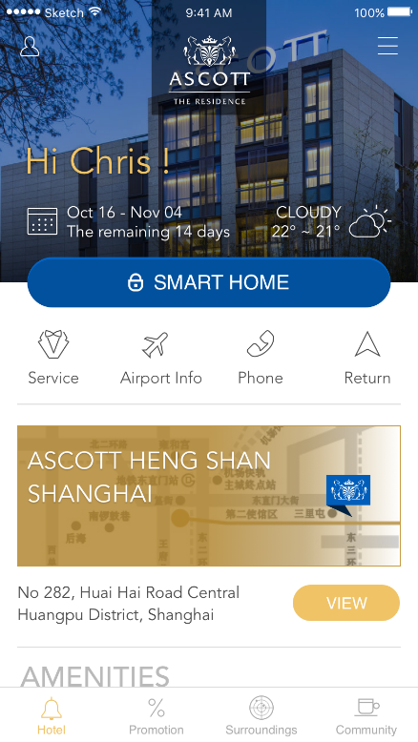
iService
Home
User User Information and settings
1
Short cut Key Sliding areas, including return apartments, news, regular calls, self-service, feedback, check-in, property, flight information, etc.
Smart Home
Smart control including mobile room key
2
3
4
See more apartment information
Main Modules Including apartment introduction, promotions, local activities, property living
5

Slide 7
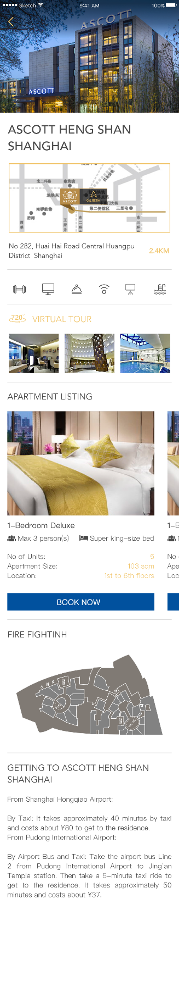
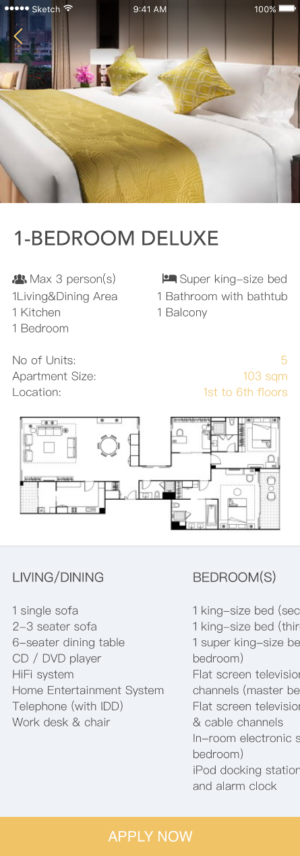


iService
Introductions
Slide
Press
Apartment introduction includes room introduction, amenities, apartment facilities, fire information, traffic information. Guests can easily obtain the various types of apartment information here

Slide 8




iService
Promotions
Filters
Can be filtered to view specific information
More details
Click to see more details and media sharing
options
Press

Slide 9

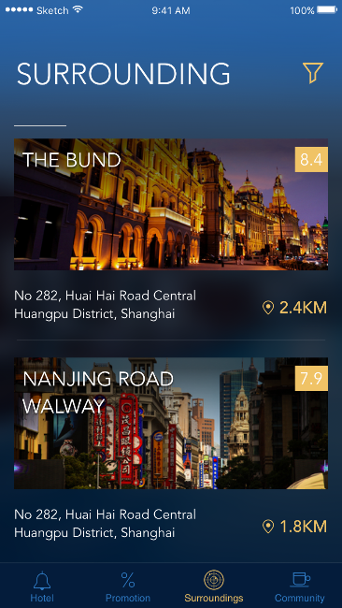
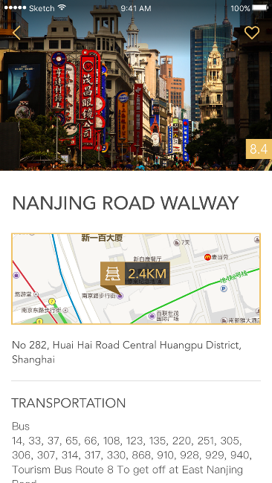

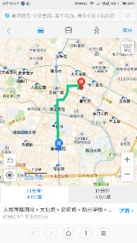
iService
Local Interest
Local interests include: food, landmarks, entertainment, hospitals, banks, travel, etc. guests can easily view
the appropriate category with a key press to navigate to the destination.

Slide 10
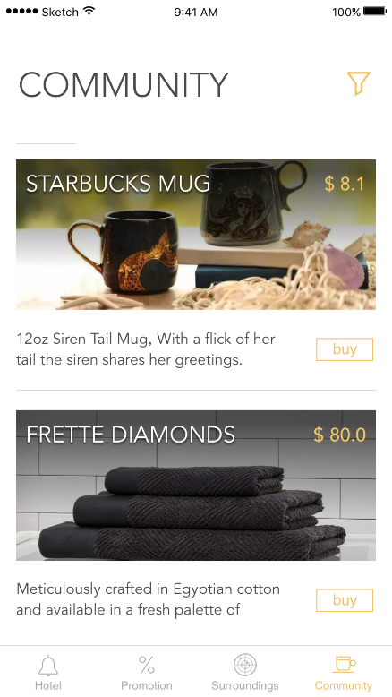


iService
Property Living
Property living includes property activities and notices, experiential shopping and feedback so that guests can better integrate into the Ascott family.

Slide 11



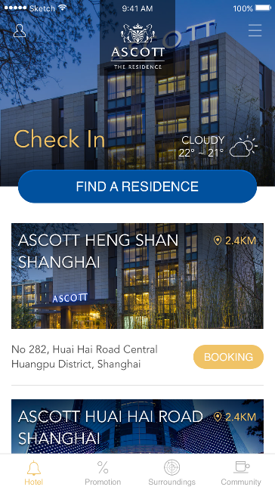
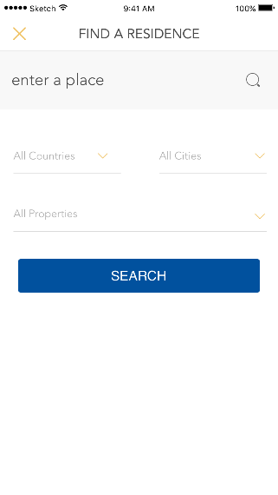
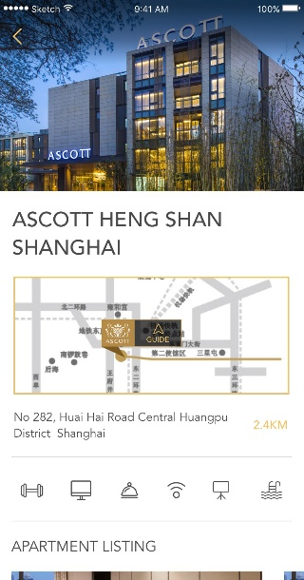
iService
Guest Mode
Search for global
properties
View property
information
Pre-Booking
Listing out properties based on the location of
phone, book for an apartment allows you to
search for a global apartment directly

Slide 12


iService
In-house guest
Login-on
Shows in-house guest information, automatically displays
the apartment facilities: smart room control, self-service,
flight information, etc.
Automatically lock if no activity,
password unlock

Slide 13
Food
Cuisine
Panoramic viewing
Shows recipes
720° room viewing
Comment
Sharing
Comment on the restaurant, and communicate with other guests
Guests can share the experience to social media
Notice
Menu
Guests can quickly get
information on any new cuisine
available
Touch the screen to view the menu and order food

Slide 14


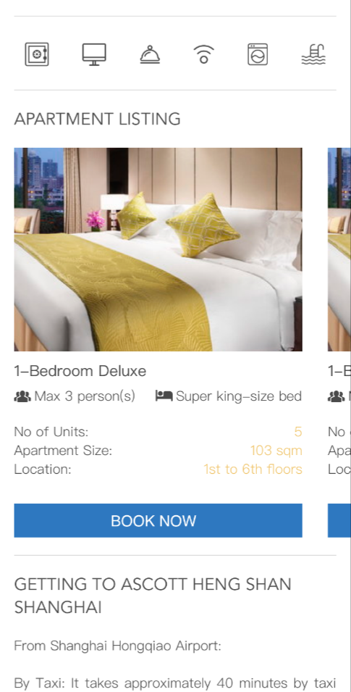
iService
Booking
Searching…
Showing the nearest
apartment automatically
Room viewing using the App
Book for room viewing
Fast & easy booking

Slide 15
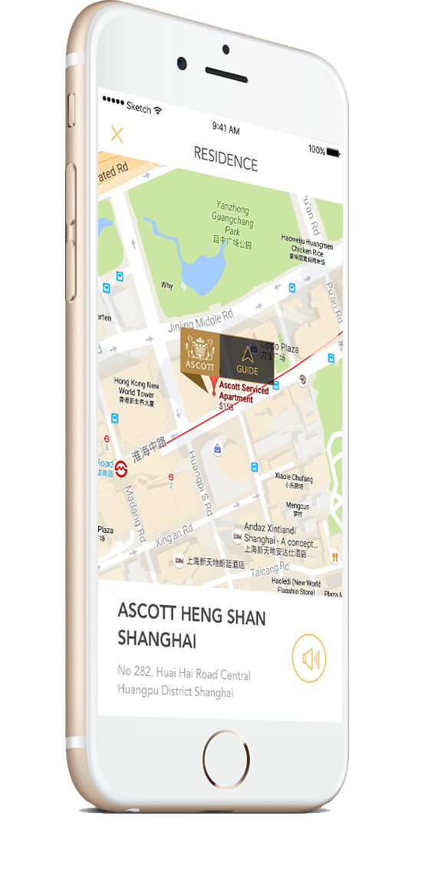

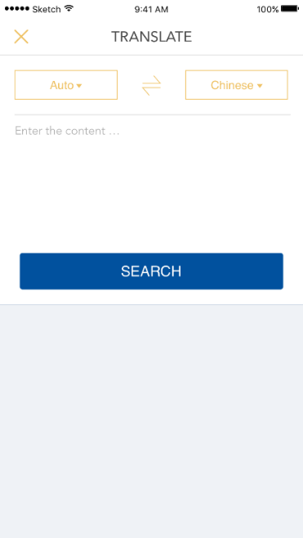
iService
Other Features
Return to Residence
Locate the location of the apartment,
displays address and can voice
broadcast in the local language
Translate
More than 20 language translations that automatically use Google translate and call locally supported translation systems when it cannot connect
to the Google API

Slide 16
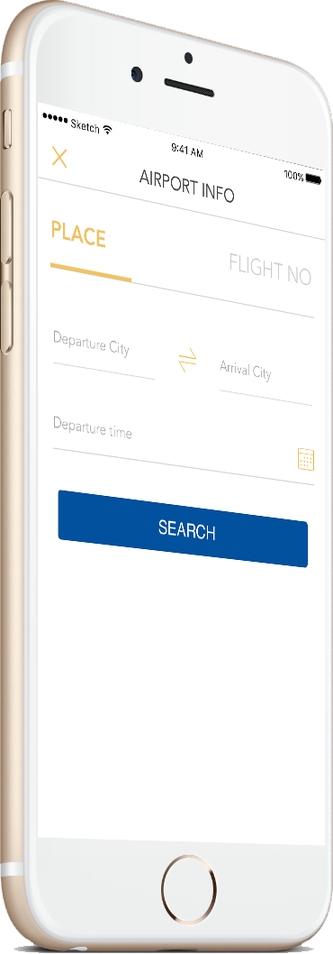
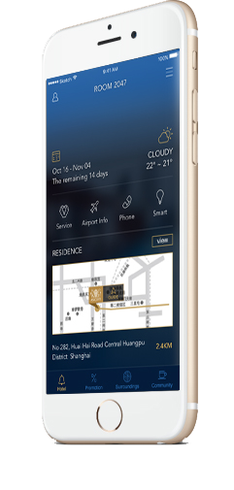

iService
Other Features
Flight information
Can provide fight information
using real-time global flight data
Navigation
Integrated map service identifies bus and walking routes.
Displays the map using the phone system language

Slide 17
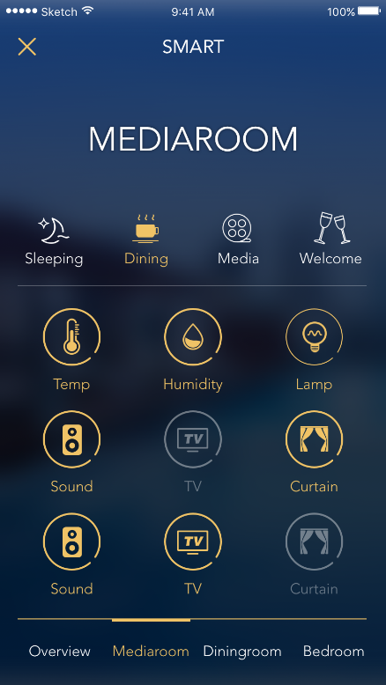
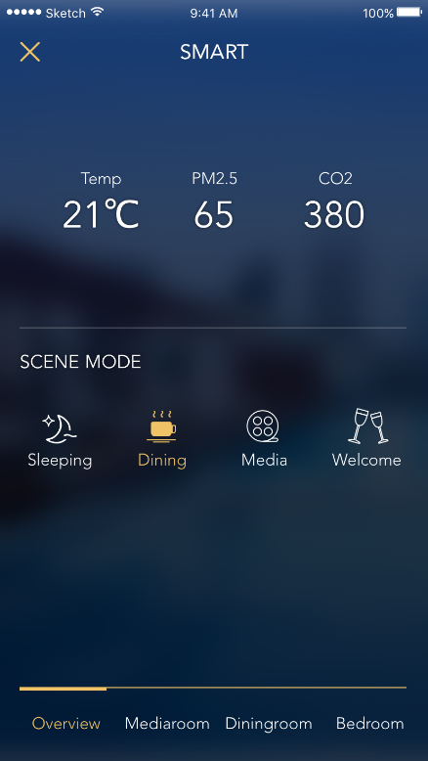
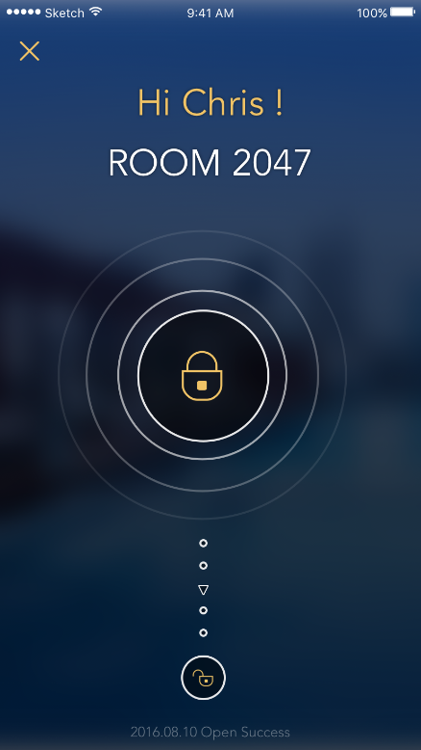
iService
Smart Room
Room Key
The app stores a secure electronic key
that can unlock the room anywhere on
the network
Smart scene settings
Customize the scene settings
Real-time status view
Temperature and humidity display.
View the room status at any location
Intelligent energy –
saving system
The room facilities automatically switch
off when the guest is not in the room
Device wake up
One key to turn all facilities on or off

Slide 18

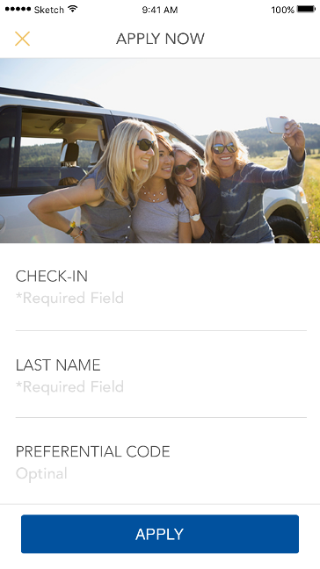
iService
Property Activities
Online Registration
Guest registry over the iService app for the property
activities
Statistics
Property staff can check the number of applicants,
automatic reminder when it reaches
the maximum number
Multimedia
Can add pictures, videos, audio recordings
and other media files
Share
Sharing to the social media with just a press of
a button

Slide 19
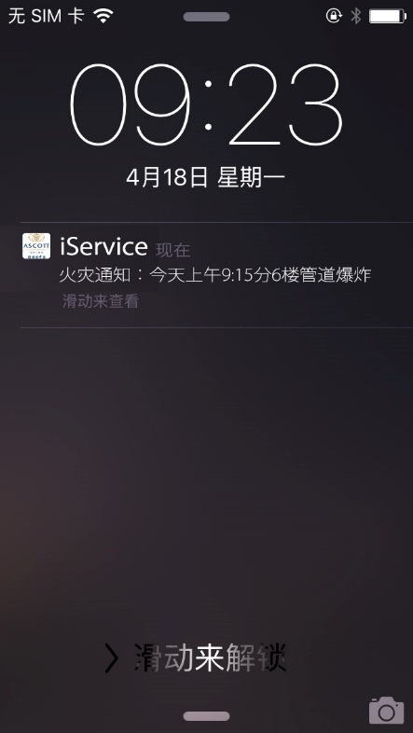
iService
iService
Pushing
Pushing
Important notices reminder
Important notices reminder
Fire, power outages and other messages pushed to the mobile
phone notification system
Fire, power outages and other messages pushed to the mobile
phone notification system
Guest history information
Guest history information
Guest can view historical information, the system automatically
retains the occupancy information and preferences
Guest can view historical information, the system automatically
retains the occupancy information and preferences
Interactive real-time message
Interactive real-time message
Share to social media

Slide 20



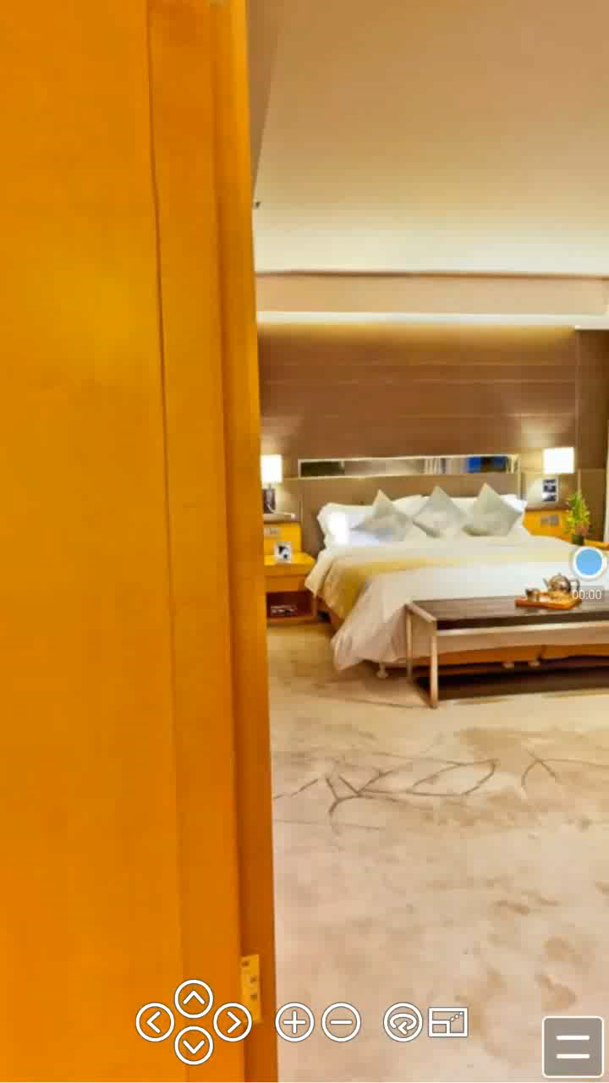
iService
720°Panoramic viewing

Slide 21

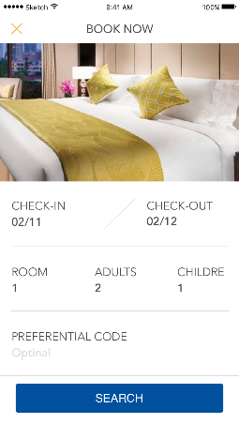
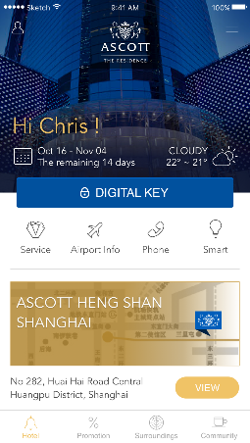
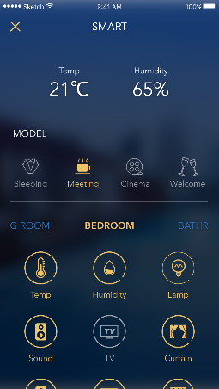
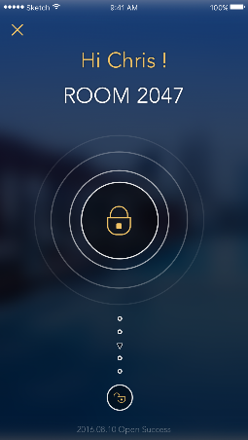

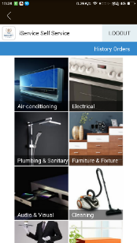

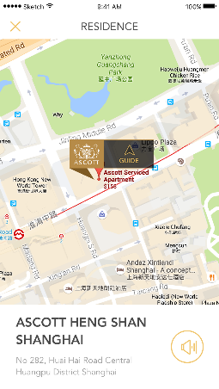

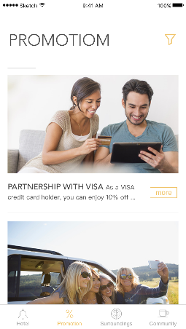

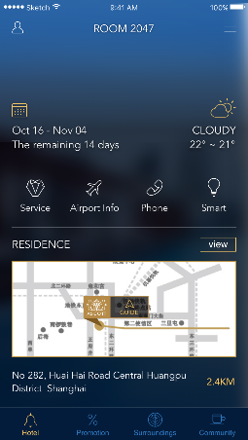
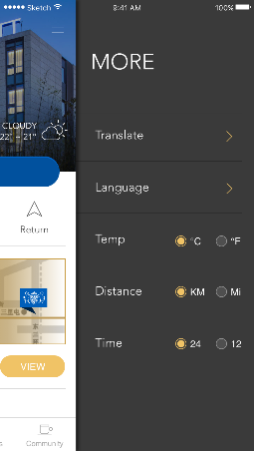
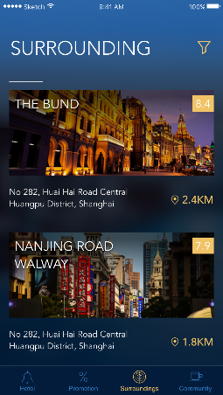
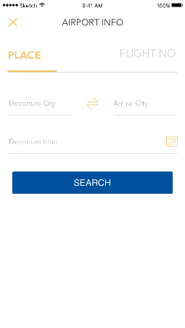
iService APP
SCREEN
Technology at your fingertips

